Slide 1
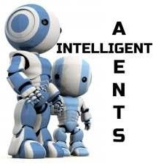

Intelligent Agents

Slide 2
Agents…
Agent: Anything That Can Be Viewed as Perceiving Its Environment
Through Sensors and Acting Upon That Environment Through Effectors…
Human Agent: Eyes, Ears and Other Organs for Sensors…Hands, Legs, Mouth and Other Body Parts For Effectors…
Robotic Agent: Cameras and Infrared Range Finders For Sensors…Various Motors For Effectors…

Slide 3
Effector vs. Actuator…
Effectors..
Any Device That Affects the Environment…
A Robot’s Effector Is Controlled by the Robot…
Effectors Range From Legs and Wheels, to Arms and Fingers…
Controller Has to Get Effectors to Produce the Desired Effect on the
Environment…
Actuators…
The Actual Mechanism That Enables the Effector to Execute an
Action…
Typical Actuators Include Electric Motors and Hydraulic Cylinders…

Slide 4
Effector vs. Actuator…
Terms Are Often Used Interchangeably to Mean “Whatever
Makes the Robot Take an Action”…But They Are Not the Same Thing…
For Example…Degree of Freedom Is Considered the Number of Ways in Which a Body or Robot Can Move or Change…
Based on This Definition:
Effectors…How Many Degrees of Freedom Does a Robot Have and How Do These Freedoms Effect the Environment…
Actuators…the Mechanism to Control One Degree of Freedom…

Slide 5
Rational Agents…
An Agent Should Strive to "Do the Right Thing" Based On What
It Can Perceive and the Actions It Can Perform…
The “Right” Action is the One That Will Cause the Agent to Be
MOST Successful…
Performance Measure: An Objective Criterion For Success of an
Agent's Behavior…
HOW and WHEN Do We Evaluate This Performance…

Slide 6
Performance Measure – HOW?…
How Do We Evaluate Performance?...
What Is the Criteria?...
Every Agent Has Its Own Measure of Performance…
Every Performance Measure Needs to Be Objective and
Measurable…

Slide 7
Performance Measure – WHEN?…
Performance Should Be Measured Over an Extended
Period of Time…
Need to Establish Trends…
Need to Establish Consistency…
Need to Account for the Ebbs and Flows of the
Environment…

Slide 8
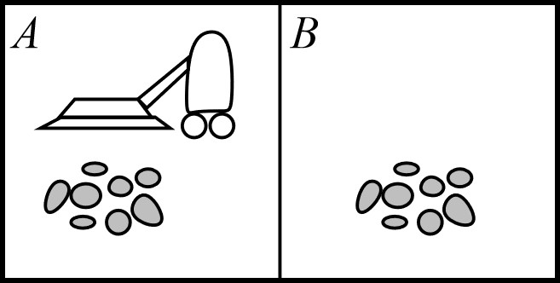
Vacuum Cleaner World...
How Measured…
Amount of Dirt Cleaned Up…
Amount of Time Taken…
Amount of Electricity Consumed…
Amount of Noise Generated…

Slide 9
Vacuum Cleaner World...
When Measured…
Does the Environment Change Depending on Time of
Day…i.e., Is There More Dirt on the Floor in the Morning?...
Is the Amount of Noise Generated Dependent or Impacted By the Amount of Dirt?...
Is the Perceived Amount of Noise Generated Impacted by Other Activities Going on Based on Time of Day?...

Slide 10
Rationality vs. Omniscience…
Rationality is Distinct From Omniscience (All-Knowing With Infinite
Knowledge)…
Rationality is Concerned With Expected Success Given What Has Been
Perceived…
Agents Can Perform Actions in Order to Modify Future Percepts So as to
Obtain Useful Information (Information Gathering, Exploration)…
Omniscience is “All Knowing” With Finite Knowledge…
Omniscient Agents Know the Actual Outcome of Its Actions and Can Act
Accordingly…
Rational Agents Observe, Explore and Learn…

Slide 11
Ideal Rational Agent…
For Each Possible Percept Sequence, an Ideal Rational Agent Should Do Whatever Action is Expected to Maximize Its Performance Measure, On the Basis of the Evidence Provided By the Percept Sequence and Whatever Built-In Knowledge the Agent Has…
For Example:
A Clock and Its Owner Take a Trip From California to Australia…
The “Right Thing” For the Clock to Do Would Be to Turn Itself Back Six Hours…
We Do Not Get Upset At Our Clocks For Failing to Do This Because We Realize
That They Are Acting Rationally, Given Their Lack of Perceptual Equipment…

Slide 12
Percept Sequence…
What Is Rational At Any Given Time Depends On Four Things:
The Performance Measure That Defines Degree of Success…
Everything That the Agent Has Perceived So Far…We Will Call This Complete Perceptual History the Percept Sequence…
What the Agent Knows About the Environment…
The Actions That the Agent Can Perform…

Slide 13
A Vacuum Cleaner Agent...
Percept Sequence | Action
[A, Clean] | Right
[A, Dirty} | Remove
[B, Clean] | Left
[B, Dirty] | Remove
[A, Clean], [A, Clean] | Right
[A, Clean], [A, Dirty] | Remove
function
Reflex-Vacuum-Agent([location,status]) returns an action
if status = Dirty then return Remove
else if location = A then return Right
else if location = B then return Left
What Is the right Function?...
Can It Be Implemented in a Small Agent Program?...

Slide 14
PEAS and PAGE Descriptions…
Before We Design an Agent Program, We Must Have Knowledge of the Following:
Possible Percepts and Actions…
What Goals or Performance Measure the Agent Is Supposed to Achieve…
What Sort of Environment It Will Operate…

Slide 15
Give PEAS a Chance…
PEAS: Stands For:
Performance Measure…
Environment…
Actuators…
Sensors…
To Design a Rational Agent, We Must First Specify the Setting or the Task Environment…

Slide 16
Four PEAS in a POD...
Consider the Task of Designing an Automated Taxi:
Performance Measure: Safety, Destination, Profits, Legality,
Comfort...
Environment: Streets, Freeways, Traffic, Pedestrians, Weather...
Actuators: Steering, Accelerator, Brake, Horn, Speaker, Display...
Sensors: Video, Accelerometers, Gauges, Engine Sensors, Keyboard, GPS...

Slide 17
Agent (Task Environment): Medical Diagnosis System…
Performance Measure: ???...
Environment: ???...
Actuators: ???...
Sensors: ???...

Slide 18
Agent (Task Environment): Medical Diagnosis System…
Performance Measure: Healthy Patient, Minimize Costs,
Lawsuits…
Environment: Patient, Hospital, Staff…
Actuators: Screen Display (Questions, Tests, Diagnoses,
Treatments, Referrals)…
Sensors: Keyboard (Entry of Symptoms, Findings, Patient's
Answers)…

Slide 19
Agent (Task Environment): Part-Picking Robot …
Performance Measure: ???...
Environment: ???...
Actuators: ???...
Sensors: ???...

Slide 20
Agent (Task Environment): Part-Picking Robot …
Performance Measure: Percentage of Parts in Correct Bins…
Environment: Conveyor Belt With Parts, Bins…
Actuators: Jointed Arm and Hand…
Sensors: Camera, Joint Angle Sensors…

Slide 21
Agent (Task Environment): Internet Shopping Agent…
Performance Measure: ???...
Environment: ???...
Actuators: ???...
Sensors: ???...

Slide 22
Agent (Task Environment): Internet Shopping Agent…
Performance Measure: Price, Quality, Appropriateness,
Efficiency...
Environment: Current and Future www Sites, Vendors, Shippers...
Actuators: Display to User, Follow URL, Fill in Form...
Sensors: Html Pages (Text, Graphics, Scripts)...

Slide 23
PAGE Descriptions…
These Can Also Be Thought of as PAGE Descriptions..
Percepts…
Actions…
Goals…
Environment…

Slide 24
Agent Types and PAGE Descriptions…
Agent Type | Percepts | Actions | Goals | Environment
Medical Diagnosis System | Symptoms, Findings, Patient Answers | Questions, Tests, Treatments | Healthy Patient, Minimize Cost | Patient, Hospital
Satellite Image Analysis System | Pixels of Varying Intensity and Color | Print a Categorization of Scene | Correct Categorizations | Images From Orbiting Satellite
Part Pickup Robot | Pixels of Varying Intensity | Pick Up Parts and Sort Into Bins | Place Parts in Correct Bins | Conveyor Belt With Parts
Refinery Controller | Temperature, Pressure Readings | Open, Close Valves, Adjust Temperature | Maximize Purity, Yield, Safety | Refinery
Interactive English Tutor | Typed Words | Print Exercises, Suggestions, Corrections | Maximize Student’s Score on Test | Set of Students

Slide 25
Environment Types...
There Are SIX Environment Types…
Observable/Accessible…
Deterministic…
Episodic…
Static…
Discrete…
Single-Agent…
Each Environment Type Impacts the Agent Differently…

Slide 26
Environment Types – Observable/Accessible…
If an Agent's Sensory Apparatus Gives it Access to the Complete State of the Environment, Then We Say That the Environment Is Accessible or Observable to That Agent…
An Environment Is Effectively Accessible If the Sensors Detect All Aspects
That Are Relevant to the Choice of Action…
An Accessible Environment is Convenient Because the Agent Need Not
Maintain Any Internal State to Keep Track of the World…
If These Conditions Are Not True, the Environment is Inaccessible…

Slide 27
Environment Types – Deterministic…
If the Next State of the Environment Is Completely Determined By the Current State and the Actions Selected By the Agents, the Environment Is
Deterministic…
In Principle, an Agent Need Not Worry About Uncertainty in an Accessible,
Deterministic Environment…
If the Environment Is Inaccessible, It May Appear To Be Nondeterministic…
This Is True if the Environment Is Complex, Making It Hard to Keep Track of All the Inaccessible Aspects...
It Is Often Better to Think of an Environment as Deterministic or Nondeterministic From the Point of View of the Agent…

Slide 28
Environment Types – Episodic…
The Agent's Experience Is Divided Into "Episodes“…
Each Episode Consists Of The Agent Perceiving And Then Acting…
The Quality Of Its Action Depends Just On The Episode Itself, Because Subsequent Episodes Do Not Depend On What Actions Occur In Previous Episodes...
Episodic Environments Are Much Simpler Because The Agent Does Not
Need To Think Ahead…

Slide 29
Environment Types – Static/Dynamic…
If The Environment Can Change While An Agent Is Deliberating, The
Environment Is Dynamic For That Agent…Otherwise It Is Static…
Static Environments Are Easy To Deal With Because The Agent Need Not Keep Looking At The World While It Is Deciding On An Action, Nor Need It Worry About The Passage Of Time…
If The Environment Does Not Change With The Passage Of Time But The Agent's Performance Score Does, Then We Say The Environment Is “Semidynamic”…

Slide 30
Environment Types – Discrete/Continuous…
If There Are A Limited Number Of Distinct, Clearly Defined Percepts And
Actions, The Environment Is Discrete…
Chess Is Discrete…There Are A Fixed Number Of Possible Moves On Each Turn…
Taxi Driving Is Continuous—the Speed And Location Of The Taxi And The
Other Vehicles Sweep Through A Range Of Continuous Values…

Slide 31
Environment Types – Single Agent…
An Agent Operating By Itself Is in a Single Agent Environment…
Any Agent in an Environment With Other Agents Is Said to Be in a Multi-
agent Environment…

Slide 32
Environment Types…
Different Environment Types Require Somewhat Different Agent
Programs To Deal With Them Effectively…
The Most Difficult Case Is Inaccessible, Nonepisodic, Dynamic, And
Continuous…
Most Real Situations Are So Complex That Whether They Are Really Deterministic Is A Moot Point…For Practical Purposes, They Must Be Treated As Nondeterministic…

Slide 33
Environment Types…
Environment | Chess With a Clock | Chess Without a Clock | Taxi Driving
Fully Observable | Yes | Yes | No
Deterministic | Strategic | Strategic | No
Episodic | No | No | No
Static | Semi | Yes | No
Discrete | Yes | Yes | No
Single Agent | No | No | No
The Environment Type Largely Determines the Agent Design…
The “Real World” Is Partially Observable, Stochastic (Not Deterministic), Sequential (Not Episodic), Dynamic (Not Static), Continuous (Not Discrete), and Multi-Agent (Not Single-Agent)…

Slide 34
What Are the Environmental Types for Each…
Type | Solitaire | Backgammon | Internet Shopping | Taxi
Observable (Detect ALL Aspects of Environment)
Deterministic (Next State COMPLETELY Determined by CURRENT State)
Episodic (Subsequent Actions NOT Dependent on Previous Episodes)
Static (Nothing Changes While Agent Decides on Next Action)
Discrete (Limited Possible Moves)
Single-Agent (Agent Operates by Themselves)

Slide 35
What Are the Environmental Types for Each…
Type | Solitaire | Backgammon | Internet Shopping | Taxi
Observable (Detect ALL Aspects of Environment) | Yes | Yes | No | No
Deterministic (Next State COMPLETELY Determined by CURRENT State)
Episodic (Subsequent Actions NOT Dependent on Previous Episodes)
Static (Nothing Changes While Agent Decides on Next Action)
Discrete (Limited Possible Moves)
Single-Agent (Agent Operates by Themselves)

Slide 36
What Are the Environmental Types for Each…
Type | Solitaire | Backgammon | Internet Shopping | Taxi
Observable (Detect ALL Aspects of Environment) | Yes | Yes | No | No
Deterministic (Next State COMPLETELY Determined by CURRENT State) | Yes | No | Partly | No
Episodic (Subsequent Actions NOT Dependent on Previous Episodes)
Static (Nothing Changes While Agent Decides on Next Action)
Discrete (Limited Possible Moves)
Single-Agent (Agent Operates by Themselves)

Slide 37
What Are the Environmental Types for Each…
Type | Solitaire | Backgammon | Internet Shopping | Taxi
Observable (Detect ALL Aspects of Environment) | Yes | Yes | No | No
Deterministic (Next State COMPLETELY Determined by CURRENT State) | Yes | No | Partly | No
Episodic (Subsequent Actions NOT Dependent on Previous Episodes) | No | No | No | No
Static (Nothing Changes While Agent Decides on Next Action)
Discrete (Limited Possible Moves)
Single-Agent (Agent Operates by Themselves)

Slide 38
What Are the Environmental Types for Each…
Type | Solitaire | Backgammon | Internet Shopping | Taxi
Observable (Detect ALL Aspects of Environment) | Yes | Yes | No | No
Deterministic (Next State COMPLETELY Determined by CURRENT State) | Yes | No | Partly | No
Episodic (Subsequent Actions NOT Dependent on Previous Episodes) | No | No | No | No
Static (Nothing Changes While Agent Decides on Next Action) | Yes | Semi | Semi | No
Discrete (Limited Possible Moves)
Single-Agent (Agent Operates by Themselves)

Slide 39
What Are the Environmental Types for Each…
Type | Solitaire | Backgammon | Internet Shopping | Taxi
Observable (Detect ALL Aspects of Environment) | Yes | Yes | No | No
Deterministic (Next State COMPLETELY Determined by CURRENT State) | Yes | No | Partly | No
Episodic (Subsequent Actions NOT Dependent on Previous Episodes) | No | No | No | No
Static (Nothing Changes While Agent Decides on Next Action) | Yes | Semi | Semi | No
Discrete (Limited Possible Moves) | Yes | Yes | Yes | No
Single-Agent (Agent Operates by Themselves)

Slide 40
What Are the Environmental Types for Each…
Type | Solitaire | Backgammon | Internet Shopping | Taxi
Observable (Detect ALL Aspects of Environment) | Yes | Yes | No | No
Deterministic (Next State COMPLETELY Determined by CURRENT State) | Yes | No | Partly | No
Episodic (Subsequent Actions NOT Dependent on Previous Episodes) | No | No | No | No
Static (Nothing Changes While Agent Decides on Next Action) | Yes | Semi | Semi | No
Discrete (Limited Possible Moves) | Yes | Yes | Yes | No
Single-Agent (Agent Operates by Themselves) | Yes | No | Yes | No

Slide 41
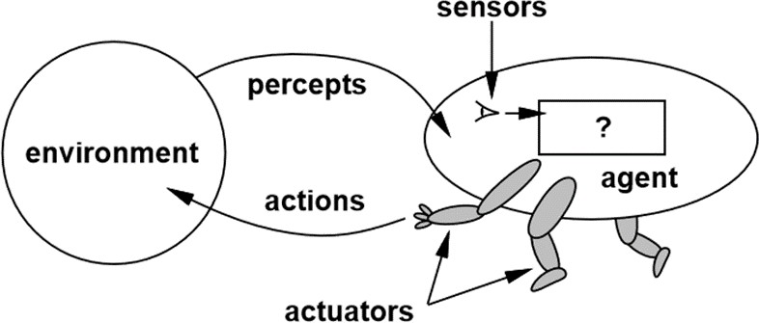
Agent Functions and Programs…
The Job of AI is to Design the Agent Program…
The Agent Program is the Action That Is Performed After Any
Given Sequence of Percepts…
The Agent Program Runs on Some Physical Computer
Architecture…
agent = architecture + program

Slide 42
Agent Types…
There Are Four Basic Types In Order Of Increasing Generality:
Simple Reﬂex Agents…
Reﬂex Agents With State…
Goal-Based Agents…
Utility-Based Agents…
All These Can Be Turned Into Learning Agents…

Slide 43
Simple Reflex Agents…
It May Be Impossible To Create Lookup Tables For Every Possible
Combination…
We Can Summarize Portions Of Commonly Occurring Input/Output
Associations…
For Example, If The Car In Front Brakes And The Lights Come On, You
Should Initiate Braking As Well…
This Is A “Condition-Action” Rule…
If “Car-in-front-is-braking” Then “Initiate Braking”
Keep in Mind…These Associations May Not Consider the “Entire World”…

Slide 44
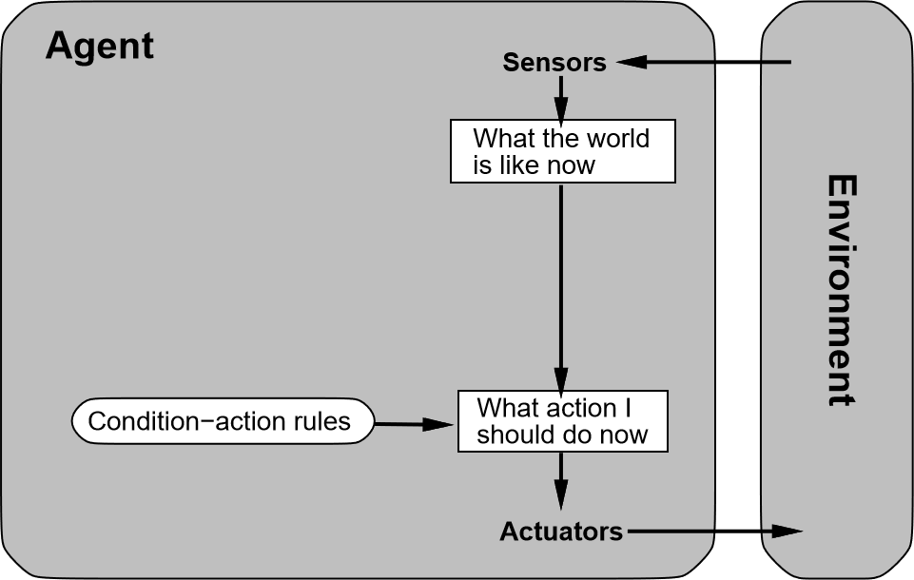
Simple Reflex Agents…

Slide 45
Simple Reflex Agents – Example…
function Reflex-Vacuum-Agent([location,status]) returns an action
if status = Dirty then return Remove
else if location = A then return Right
else if location = B then return Left
(setq joe (make-agent :name ’joe :body (make-agent-body)
:program (make-reflex-vacuum-agent-program)))
(defun make-reflex-vacuum-agent-program ()
#’(lambda (percept)
(let ((location (first percept)) (status (second percept))) (cond ((eq status ’dirty) ’Remove)
((eq location ’A) ’Right)
((eq location ’B) ’Left)))))

Slide 46
Reflex Agents With States…
A Problem Can Arise When The Sensors Do Not Provide Access To The Complete State Of The
World…
In These Cases, The Agent Needs To Maintain Some Internal State Information To Distinguish
Between World States So That Different Actions Are Appropriate In Different States…
Updating This Internal State Information As Time Goes By Requires Two Kinds Of Knowledge
To Be Encoded In The Agent Program…
Information About How The World Evolves Independently Of The Agent—for Example, That An
Overtaking Car Generally Will Be Closer Behind Than It Was A Moment Ago…
Information About How The Agent's Own Actions Affect The World—for Example, That When The Agent Changes Lanes To The Right, There Is A Gap (At Least Temporarily) In The Lane It Was In Before, Or That After Driving For Five Minutes Northbound ; On The Freeway One Is Usually About Five Miles North Of Where One Was Five Minutes Ago…

Slide 47
Reflex Agents With States…Part 2
The Current Percept Is Combined With The Old Internal State To
Generate The Updated Description Of The Current State…
The UPDATE-STATE Is Responsible For Creating The New Internal State Description. As Well As Interpreting The New Percept In The Light Of Existing Knowledge About The State…
It Uses Information About How The World Evolves To Keep Track Of The
Unseen Parts Of The World…

Slide 48
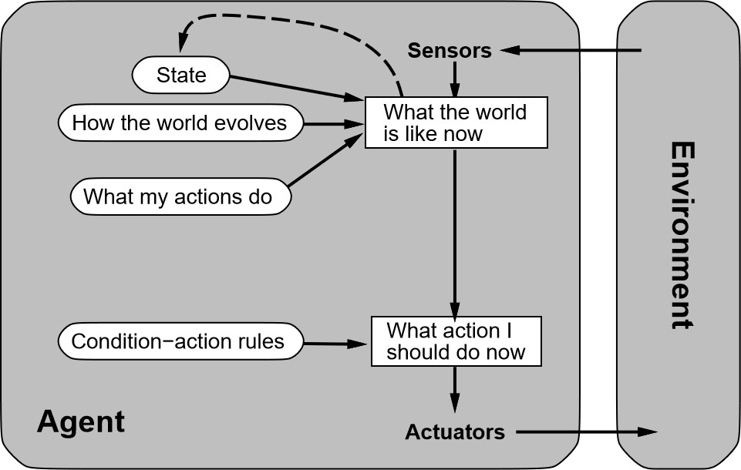
Reflex Agents With States…

Slide 49
Reflex Agents With States…
function Reflex-Vacuum-Agent([location,status]) returns an action
static: last A, last B, numbers, initially ∞
if status = Dirty then ...
(defun make-reflex-vacuum-agent-with-state-program () (let ((last-A infinity) (last-B infinity))
#’(lambda (percept)
(let ((location (first percept)) (status (second percept)))
(incf last-A) (incf last-B) (cond
((eq status ’dirty)
(if (eq location ’A) (setq last-A 0) (setq last-B 0)) ’Remove)
((eq location ’A) (if (> last-B 3) ’Right ’NoOp))
((eq location ’B) (if (> last-A 3) ’Left ’NoOp)))))))

Slide 50
Goal Based Agents…
Knowing About The Current State Of The Environment Is Not Always Enough To
Decide What To Do…
In A Current State Description, The Agent Needs Some Sort Of Goal
Information, Which Describes Situations That Are Desirable…
The Agent Program Can Combine This With Information About The Results Of
Possible Actions In Order To Choose Actions That Achieve The Goal…
This Can Be Simple (When Goal Satisfaction Results Immediately From A Single Action) or Very Complex (When The Agent Has To Consider Long Sequences Of Twists And Turns To Find A Way To Achieve The Goal)…

Slide 51
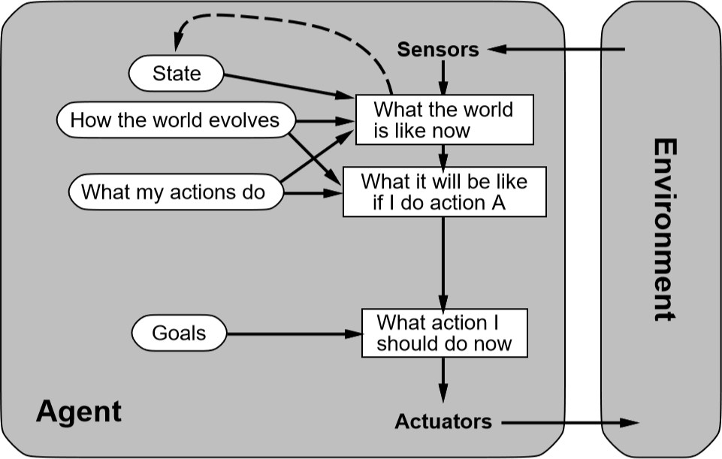
Goal Based Agents…

Slide 52
Utility Based Agents…
Goals Alone Are Not Really Enough To Generate High-Quality Behavior…They Provide A Distinction Between "Happy" And "Unhappy" States…
For Example, There Are Many Action Sequences That Will Get The Taxi To Its Destination, Thereby Achieving The Goal, But Some I Are Quicker, Safer, More Reliable, Or Cheaper Than Others…
A More General Performance Measure Should Allow A Comparison Of Different States (Or
Sequences Of States) According To Degrees of “Happy” or “Unhappy”…
If One State Is Preferred To Another, It Has Higher Utility For The Agent…
The Word "Utility" Here Refers To "The Quality Of Being Useful" If We Measure The Utility Of
An Agent Over The Long Run…
The Utility Is Good For When There Are Conflicting Goals or When There Are Several Goals
and None Can Be Achieved With Certainty…

Slide 53
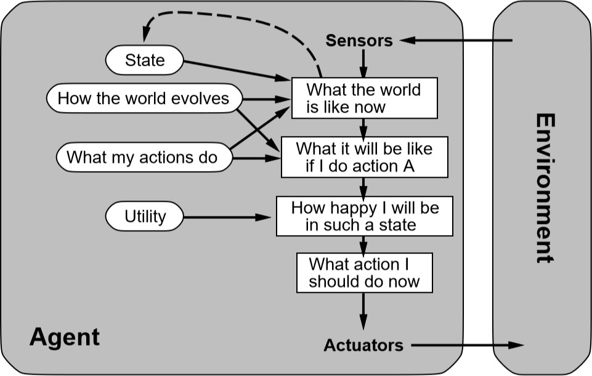
Utility-Based Agents…

Slide 54
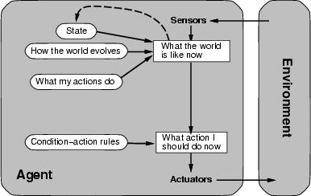
Model Based Reflex Agents…

Slide 55
Simple Reflex Agents – Example…
function
Reflex-Vacuum-Agent([location,status])
returns an action
Static: last_A, last_B, numbers, etc.
if status = Dirty then return Remove else if location = A then return Right else if location = B then return Left
(defun make-reflex-vacuum-agent-with-state-program () (let ((last-A infinity) (last-B infinity))
#’(lambda (percept)
(let ((location (first percept)) (status (second percept)))
(incf last-A) (incf last-B)
(cond
((eq status ’dirty)
(if (eq location ’A) (setq last-A 0) (setq last-B 0))
’Remove)
((eq location ’A) (if (> last-B 3) ’Right ’NoOp)) ((eq location ’B) (if (> last-A 3) ’Left ’NoOp)))))))

Slide 56
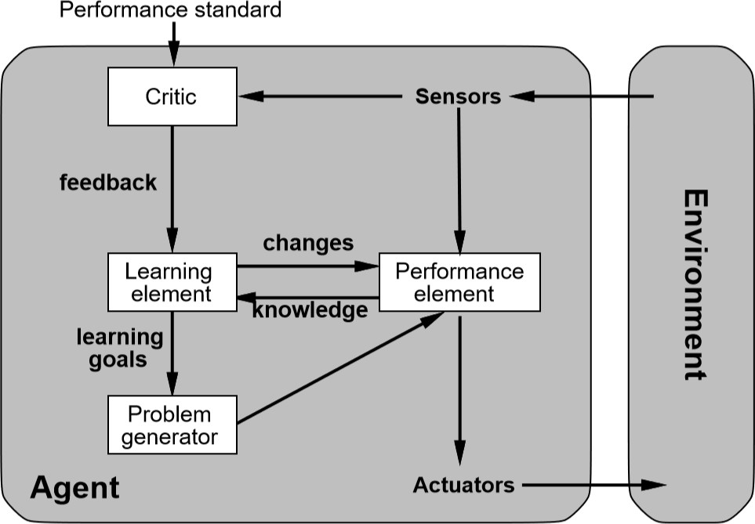
Learning Agents…

Slide 57
Summary...
Agents Interact With Environments Through Actuators And Sensors…
The Agent Function Describes What The Agent Does In All Circumstances…
The Performance Measure Evaluates The Environment Sequence…
A Perfectly Rational Agent Maximizes Expected Performance…
Agent Programs Implement (Some) Agent Functions…
PEAS Descriptions Define Task Environments…
Environments Are Categorized Along Several Dimensions: Observable, Deterministic, Episodic, Static, Discrete, Single-Agent…
Several Basic Agent Architectures Exist: Reﬂex, Reﬂex With State, Goal-Based, Utility-Based…

Slide 58
Questions?...

